Slide 1
Tax Evasion

Slide 2
Tax Avoidance
Not illegal practice.
Avoiding taxes using the law and its ambiguities.
Allows to reduce revenues declared to tax services.
Still is an abusive behaviour towards law.

Slide 3
Tax Evasion
Illegal practice
Process of hiding a part of revenues to reduce taxes
Can be voluntary or the result of an error
Subject to penalties from tax services

Slide 4
How does it works in France ?
2 types of tax evasion:
From private individuals
From big companies

Slide 5
Tax evasion from private individuals
Process: Hiding accounts located in foreign countries to tax services.
➔ In France, 91% people caught by tax services declared to have been domiciliated in Switzerland.

Slide 6
Tax evasion from companies
There are different processes resulting of abusive fiscal practices:
Unfair mergers and group arrangements
Double Irish
Transfer Pricing adjustment

Slide 7
Unfair mergers and group arrangements
Group
Group
Very benefitial company
Company in deficit
Unfair merging of those companies to reduce declared revenues

Slide 8
Double Irish
sale of products in france
Returns to the mother company located in another country
Brand fee
Commission <5% of total revenues: part which will be taxed in France
Revenues located in a jurisdiction with no income taxes

Slide 9
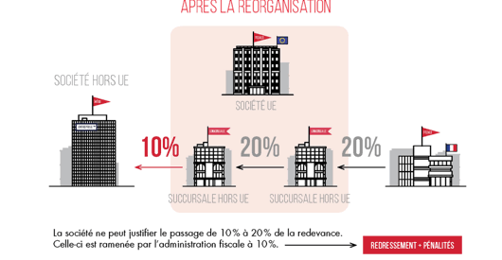
Transfer pricing adjustment
Parent company outside EU
Royalty
Company in EU
Company in France
Branch outside EU
Branch outside EU
Royalties should be 10%, here there is 20%, meaning that additional 10% escape French taxation. If the company can’t justify it: tax services put back the royalties at 10% of turnover and applies a penalty up to 80% of this turnover.

Slide 10
What is the loss ?
Every year it represents around 100 billion euros in France.
It is the budget for education.
As a result: French budget deficit= 83 billion euros

Slide 11
Esscaland
How to struggle against tax evasion ?

Slide 12
Guarantee to have the most information possible
Concerning people from Esscaland and their accounts in foreign countries
From employers, social organizations and banks through pre-filled tax return
From whistelblowers with compensation in return, as in France

Slide 13
Guarantee efficient control and penalties
Avoid ambiguities in the law, if a new type of tax evasion appears, adopt new laws constantly.
Stronger penalties:
- « name and shame »: publicly denounce cheaters to other citizens, make sure they are blacklisted from some institutions.
- Prison sentences that have to be executed, no threats like in France, real execution of sentences.
Education of young citizens concerning taxes, make it easier to pay taxes, give no excuses to fraudsters

Slide 14
Consequences
Companies avoiding Esscaland ➔ decrease in economic activity.
Departure of some big fortunes in countries less careful towards taxation.
Possible discontent of a part of the population as their revenues & tax informations would become more transparent.

